Slide 1
Extending the Reliability Model of Cellular Aging
Biology 320 Genomics and Proteomics
Jessica Christopher
Jessika Williams
Dr. Hong Qin

Slide 2
Outline
What is aging?
What is Reliability Theory?
How can a biological system be represented by R studio?
Code and what it represents
Failure Rates and Viability
Conclusions
Future Direction
References

Slide 3
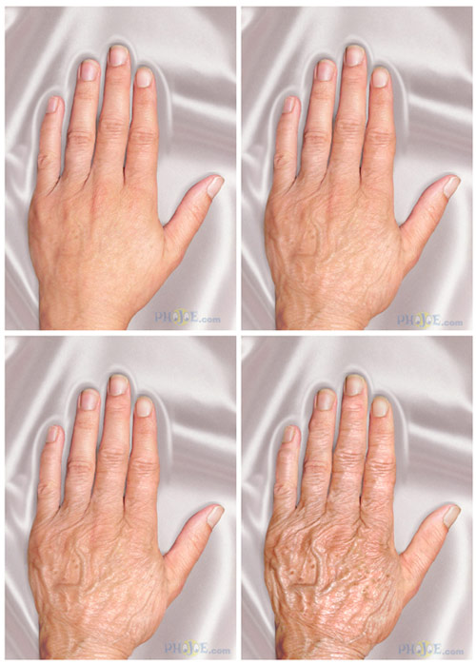
Aging
the increasing chance of failure with time
Functional failure of components and systems of the biological systems
How do we age?
Notes:
Why do most biological species, including humans, deteriorate with age?

Slide 4
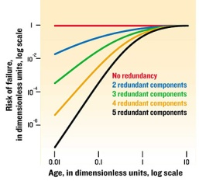
Reliability Theory
Components of system are functionally redundant, in parallel
System only fails when all of the components fail
When one system fails, a group of systems fails
Group of systems = organism
System = organ
Component = cell

Slide 5

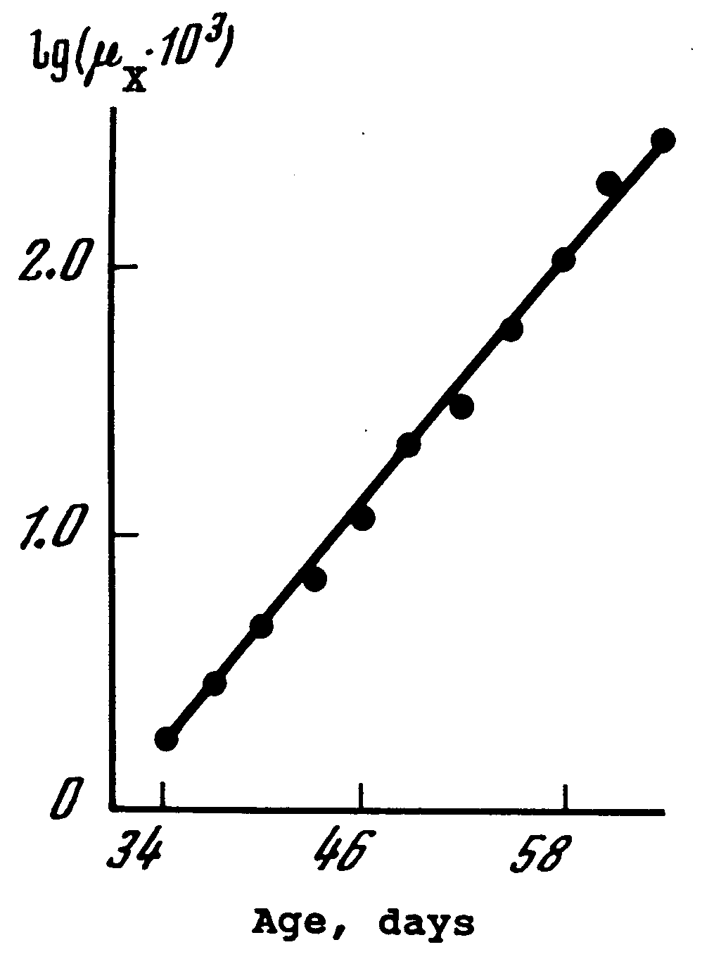
Gompertz Model
Failure rate increases exponentially with age as redundant components fail
μ(x) = mortality rate
A = age-independent component
R x exp(αx) = age-dependent component, based on the failure of components
Gompertz Law of Mortality
Log of Failure Rate
Time

Slide 6
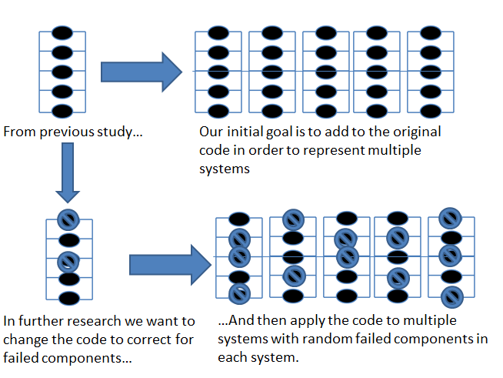
Our Goals

Slide 7
Biological Systems in R studio
The lifespan of the biological system is simulated
Define values: m, n, Npop
Rpois() command

Slide 8
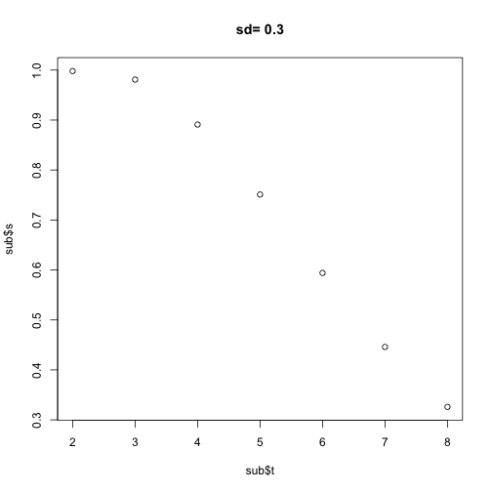
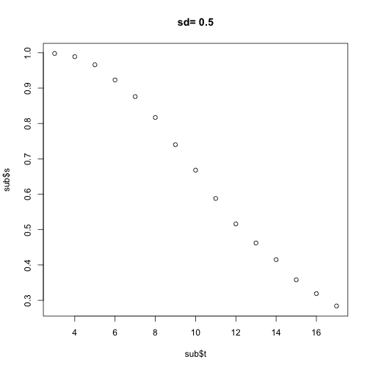
Previous Studies
One system, fixed elements
Heterogeneous components
Standard deviations – measure of heterogeneity (higher the sd, the more heterogenous)
Exponential increase of mortality rate over time = Gompertz model
Viabilty
Time
Viabilty
Time

Slide 9
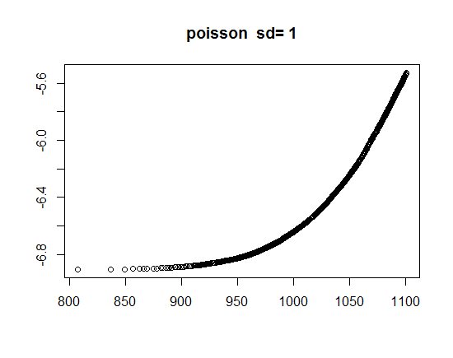

Failure Rate
Failure Rate
Failure Rate
Time
Time

Slide 10
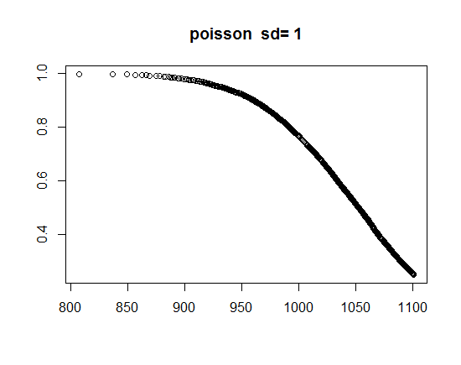
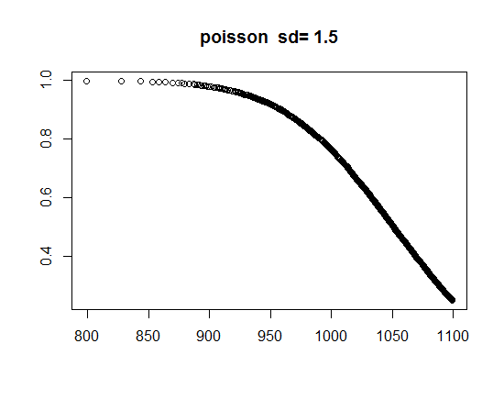
Viability
Viability
Viability
Time
Time

Slide 11
Conclusions & Future Work
Based on the plots for viability and failure rates, our simulation of an aging biological system represents the Gompertz model formulated by Gavrilov
In previous research, there appeared to a be a correlation between standard deviation and failure rate. However, this is not seen in our results. Thus,
We need to decrease the poisson mean and increase standard deviation noise level of decay rate in order to see if the latter plays a role

Slide 12
References
Gavrilov, Leonid., Gavrilova, Natalia., (2001). The Reliability Theory of Aging and Longevity. 528-536
Gavrilov, Leonid., Gavrilova, Natalia. (2006). Models of Systems Failure in Aging. 47-51, 57-60.
Gavrilov, Leonid., Gavrilova, Natalia. (2003). The Quest for a General Theory of Aging and Longevity. 2-7.
Hellemans, Alexander, Mullins, Justin, Lal, Amit. “Why We Fall Apart”. IEEE Spectrum, Vol. 41, no. 9. September 2004, p. 3.

